Slide 1


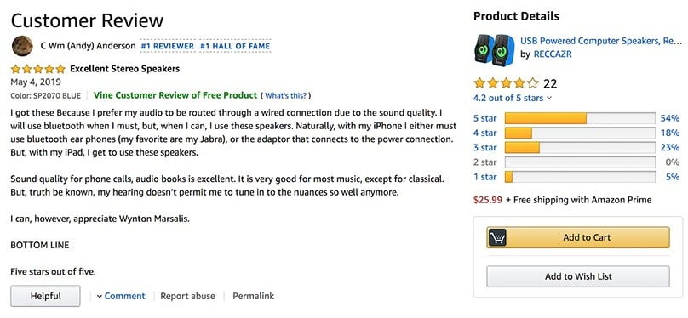
Amazon Reviews
Sentiment Analysis By Ashreen Kaur Oberoi

Slide 2
Summary
There are 10 brands ASUS, Apple, Google, HUAWEI, Motorola, Nokia, OnePlus, Samsung, Sony, and Xiaomi. Dataset comprises 82,815 reviews from Amazon regarding smart phones since 2004 until Sep 2019. Each review is associated with an item, brand name and comes with a rating ranging from 1 to 5.

Slide 3
About
CSV
Items.csv
Reviews.csv
Rows: 793
Columns: 9
Rows: 82816
Columns: 8

Slide 4
Objectives
Establishing sucees of the product by predictive ratings,using sentiments.
Extracting words used by the customers to describe the products.

Slide 5
Techniques Used
TF-ID vectorizer.
LinearSVM classifier.
Logistic regression classifier.
MultinomialNB.
Topic Modelling.

Slide 6
Contact
Name: Ashreen kaur Obeori
Email : oberoiashreen15@gmail.com

